Slide 1
NEP – 2020 : School Connect

Slide 2
NEP – 2020 : School Connect Programme
AZAD MAHAVIDYALAYA, AUSA.
Chairperson
Dr. E.U. Masumdar
Principal
Resource Persons
Dr. Syed N.K.
HOD English
Dr. M. A. Barote
IQAC Coordinator & HoD, Physics
Azad Mahavidyalaya, Ausa.

Slide 3
Necessity of New Education Policy
Severely fragmented higher educational ecosystem
Rigid separation among disciplines, with early specialization and streaming of students into narrow areas of study
Less emphasis on the development of cognitive skills and learning outcomes
Limited access in socio-economically disadvantaged areas, particularly in HEIs that are taught in local languages
Lack of vocational / skill component
Limited / no autonomy to teachers and institutions
Large affiliating universities resulting in low standards of undergraduate education
Ineffective mechanisms for merit-based career management and progression of faculty and institutional leaders
Less emphasis on research and lack of competitive peer reviewed research funding across disciplines
Ineffective regulatory system

Slide 4
NEP-2020 Vision
India-Centered education system that directly contribute in transforming the Nation sustainably into an Equitable and Vibrant knowledge society by providing high-quality education to all

Slide 6
5+3+3+4 ……………. Ph D
NEP-2020 lays down comprehensive reforms that will every student, all the way from play group to an ambitious Master leading to Ph D

Slide 7
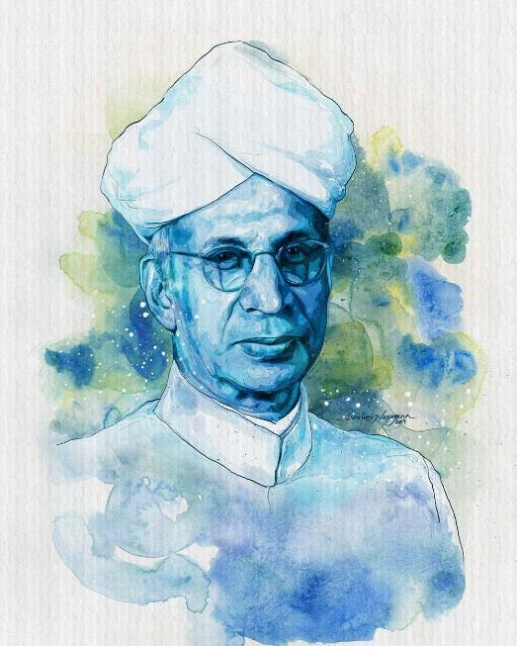
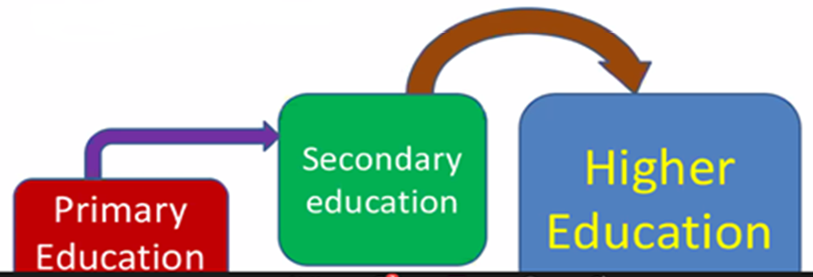
Secondary education occupies a Strategic Position in the Indian Educational Pattern
It is the link between the Primary and Higher Education

Slide 8
Objectives Of NEP 2020
Revamp School Education System
Student-Centric Education System
Create world-class multidisciplinary higher education institutions
Raise GER from 80 to 100% in school education by 2035 and to 50% in HE by 2025
Aims to bring two crore out of school children back into the main stream
Build world-class universities and achieve high global ranking

Slide 9
राष्ट्रीय शिक्षण धोरण – 2020 ची उद्दिष्टे

Slide 10
Key Principles of NEP-2020
The NEP 2020 curriculum framework offers
The flexibility to move from one discipline of study to another (Arts to Commerce or Science)
The opportunity for learners to choose the courses of their interest in all disciplines (Arts students can learn Science, Engineering subjects or vice versa)
The multiple entry and exit (MEME) options with the award of UG certificate/ UG diploma / three-year degree based on credits earned
The flexibility for learners to move from one institution to another enabling them to have multi and/or interdisciplinary learning
moving towards faculty and institutional autonomy
revamping curriculum, pedagogy, assessment, and student support for enhanced student experiences

Slide 11
Key Principles of NEP-2020

Slide 12
Key Principles of NEP-2020
Academic Bank of Credits (ABC)
NEP 2020 envisage an Academic Bank of Credit.
The credits earned by the students can be stored and would be counted at the time of final degree

Slide 13
Certificate
Certificate
Diploma

Slide 14
Skill Gap Analysis
Anticipating current trends in the market and reorienting learning opportunities
Traditional jobs that existed till the time will become outdated due to inclusion of advanced technology
In coming time about 85 million jobs will be lost
But 100 million NEW jobs will be created – We need to prepare ourselves to grab those
Envisage severe shortage of Competent Telent
Job Opportunities in coming time will be based on NEW SKILLS
University plan to start required short term

Slide 15
Salient Features of NEP-2020
Multidisciplinary and Holistic Education
Imaginative / flexible Curriculum Structure and Length of Programs
Multiple Entry / Multiple Exit
Wide range of Elective Courses of multidisciplinary nature
Choice Based Credit System - integrated with - Academic Bank of Credits (ABC)
Ending Fragmentation
Skills and Values - Mapping of skills for better employability
Introducing more programmes in vocational education
Including the component of research and internship in the curriculum
The project-work / dissertation / internships may be conducted in collaboration with industry
Start-ups and Setting up start-up incubation centers
Internships - opportunities for internships with local industry
Establishing partnership with the Ministries/ Organizations/ Institutions
Multidisciplinary Education and Research Universities (MERU) - Multidisciplinary Research

Slide 16
Salient Features of NEP-2020
Multidisciplinary and Holistic Education
Imaginative / flexible Curriculum Structure and Length of Programs
Multiple Entry / Multiple Exit
Wide range of Elective Courses of multidisciplinary nature
Choice Based Credit System - integrated with - Academic Bank of Credits (ABC)
Ending Fragmentation
Skills and Values - Mapping of skills for better employability
Introducing more programmes in vocational education
Including the component of research and internship in the curriculum
The project-work / dissertation / internships may be conducted in collaboration with industry
Start-ups and Setting up start-up incubation centers
Internships - opportunities for internships with local industry
Establishing partnership with the Ministries/ Organizations/ Institutions
Multidisciplinary Education and Research Universities (MERU) - Multidisciplinary Research

Slide 17
Empowering students through flexibility in course choices
Flexibility to choose courses - including subjects in physical education, the arts and crafts, and vocational skills – so that students can design their own paths of study and derive life plans
Holistic development and a wide choice of subjects and courses is the distinguishing feature
No hard separation among ‘curricular’, ‘extracurricular ’, or ‘co-curricular’, among ‘arts’, ‘humanities’, and ‘sciences’, or between ‘vocational’ or ‘academic’ streams.
Subjects such as physical education, the arts and crafts, and vocational skills, in addition to science, humanities, and mathematics, will be incorporated

Slide 18
Credit Distribution
Major (Core) Subject (Mandatory and Elective Courses DSC/DSE)
Minimum 50% of total credits in 3/4- year UG Degree
Offered in all Four years
2 credit course on Major Specific IKS
Elective courses in the third and/or final year.
Vocational Skill Courses
Internship/ Apprenticeship / Field Projects / Research Projects
B. Minor Subject (DSM, 18-20 Credits)
DSM may be from the different disciplines of the same faculty of DSC Major (Core) or can be from different faculty altogether
The credits shall be completed in the first three years
C. Generic/ Open Elective Courses (OE, 10-12 credits)
Offered in I and/or II year
Faculty-wise baskets of OE
OE is to be chosen compulsorily from faculty other than that of the Major
D. Vocational and Skill Enhancement Courses (VSEC, 14-16 credits)
Vocational Courses (VSC, 8-10 credits)
Includes Hands on Training corresponding to the Major and/or Minor Subject
To be offered in first three years
Skill Enhancement Courses (SEC, 06 credits)
To be offered in I and II year; ii and be selected from the basket of Skill Courses

Slide 19
Credit Distribution
Ability Enhancement Courses (AEC - 08 credits)
To be offered in I and II year
English (04 Credits) and Modern Indian Language: 04 credits
To be offered from the Basket approved by University / Autonomous College
The focus for both languages should be on linguistic and communication skills
F. Indian Knowledge System (IKS - 2 Credits)
To be offered in I Year ii
Courses on IKS to be selected from the basket of IKS
G. Value Education Courses (VEC - 04 Credits)
To be offered in I year ii
VEC such as Understanding India, Environmental Science/Education, and Digital and Technological Solutions
Field Projects/ Internship/ Apprenticeship/ On Job Training (12-16 credits)
Correspond to the Major (Core) Sub
To be offered in II, and III years
Co-curricular Courses (CC – 8 credits)
NSS / NCC / Health and Wellness / Yoga education / Sports and Fitness / Cultural Activities / Fine, Applied, Visual, Performing Arts
To be offered in I and/or II year
Research Projects: 12 credits
To be offered in the final year for 4 year Honours with Research UG Degree

Slide 20
B. End Semester Assessment (80% of the Maximum Marks)

Slide 21
CONCLUSION
NEP-2020 – Truly Student Centric Education Policy
Need Based, Choice Based, Flexible System
Every Credit Earned Shall be Accounted For
Capable to learn skill of his own choice
Couple credits of skill based learning to get Degree
By its effective implementation, the Indian academic system will take a quantum jump
Of course, its responsibilty lies on the shoulder of the Teachers

Slide 22
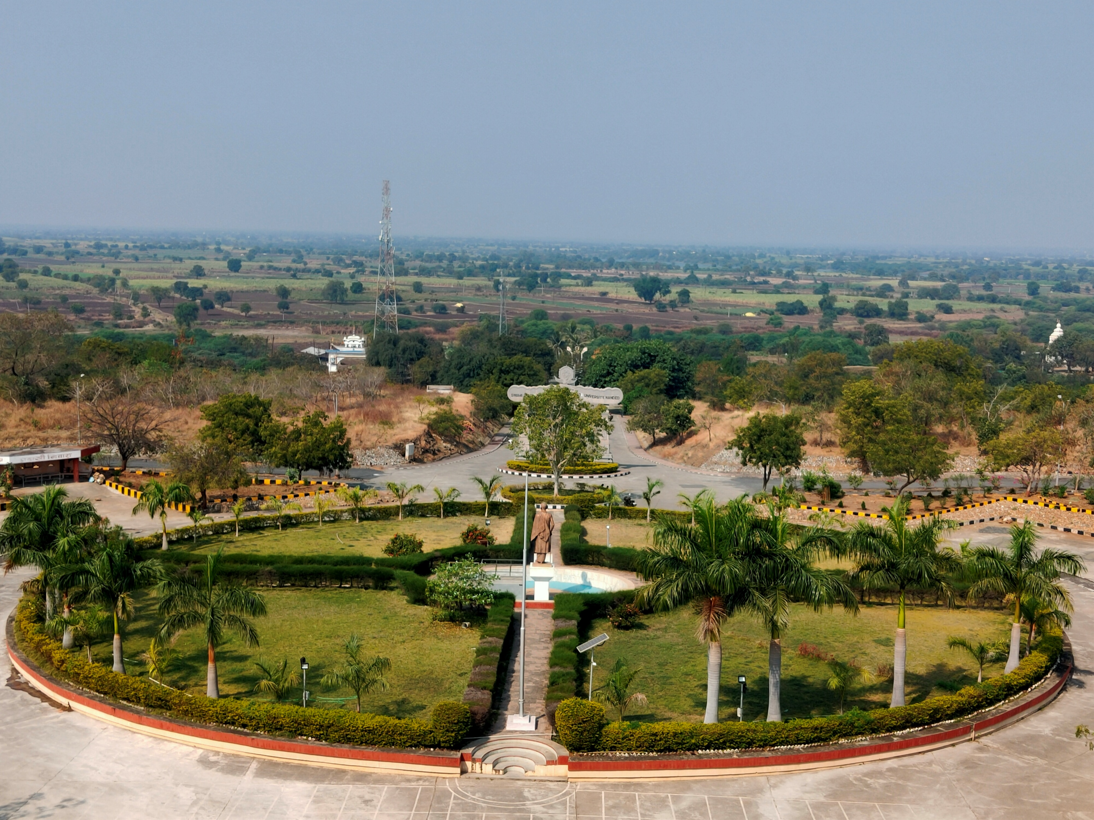
THANK YOU
(79)
Notes:
22
22
22

